Slide 1
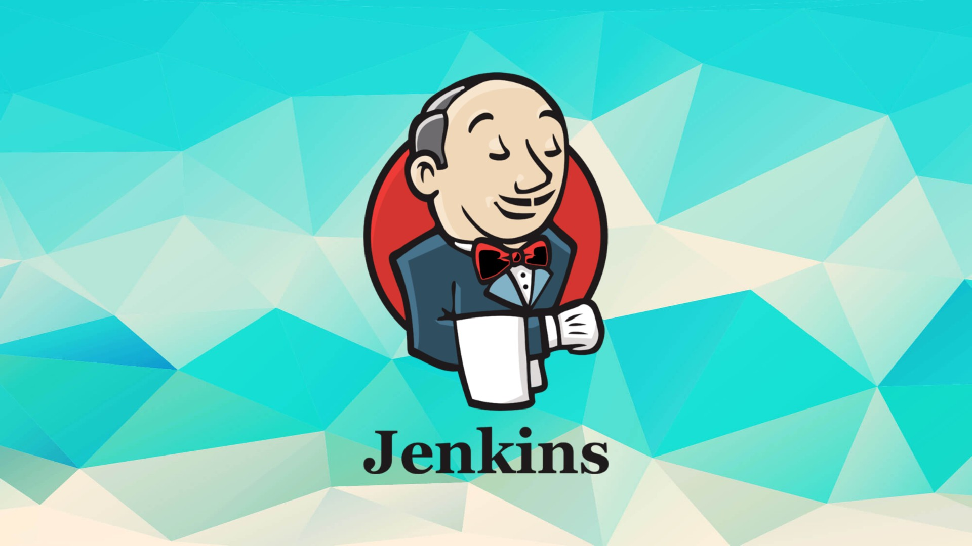
Continuous Integration With Jenkins

Slide 2
WHAT IS JENKINS
Jenkins is an open source automation tool written in java-programming language that allows continous integration.
Jenkins will build and test the code. It supports continuous integration (CI) and continuous delivery (CD) pipelines, allowing teams to quickly integrate changes into a project and automate the deployment process.
This Photo by Unknown Author is licensed under CC BY-SA

Slide 3
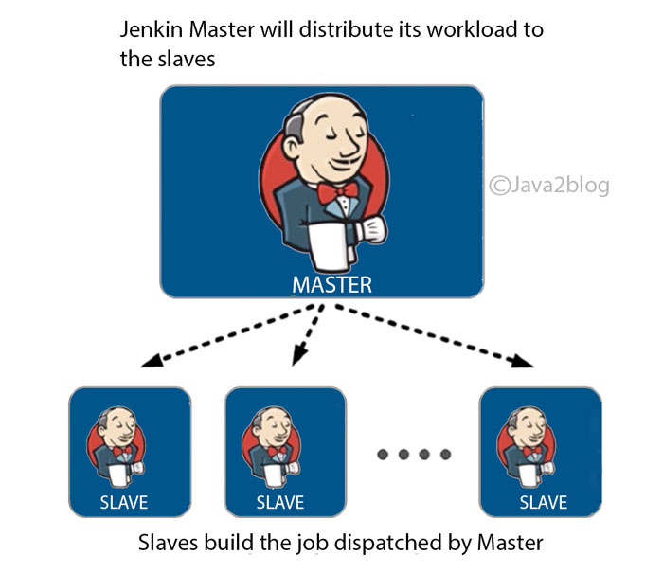
ARCHITECTURE OF JENKINS

Slide 4
Advantages of jenkins
OPEN SOURCE
EXTENSIVE PLUGIN ECOSYSTEM
EASY INSTALLATION AND CONFIGURATION
SUPPORT FOR MULTIPLE LANGUAGES
CONTINUOUS INTEGRATION AND CONTINUOUS DELIVERY
DISTRIBUTED BUILDS
SCALABILITY
CUSTOMIZATION
INTEGRATION WITH DEVEOPS TOOLS
ROBUST COMMUNITY AND SUPPORT

Slide 5
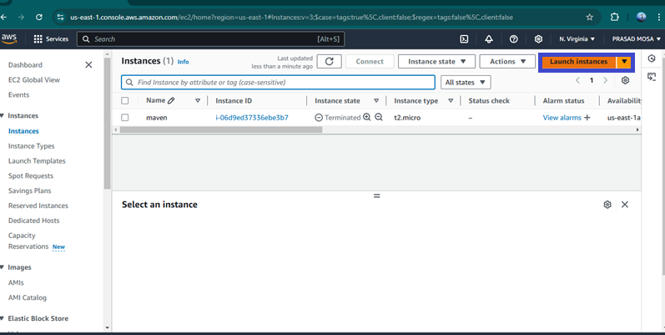
STEP 1: First we Need to Create one Ec2 instance in Aws console First click on launch ec2 instance in Dashboard

Slide 6
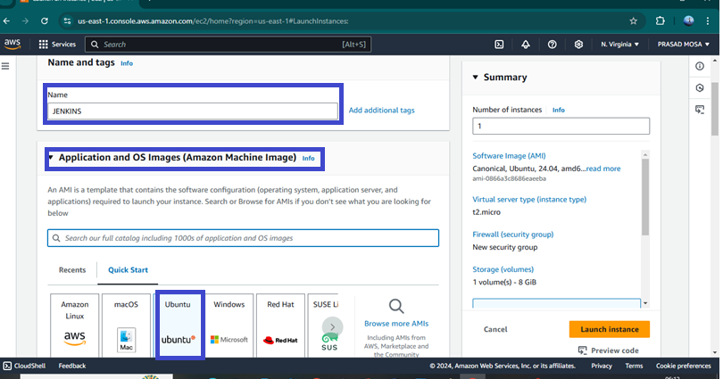
after click on launch instance need to provide name and select ami(like linux,ubuntu)

Slide 7
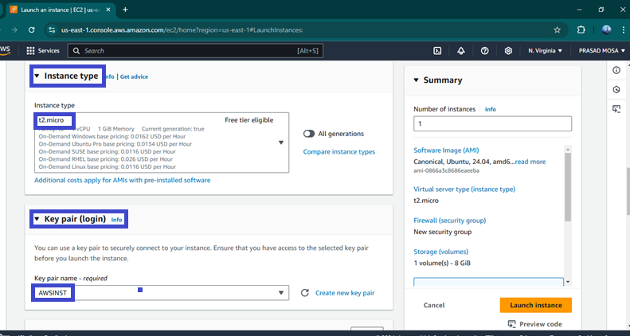
Then select Instance Type as t2.large and select any existing key pair or create new key by click create new key pair.

Slide 8
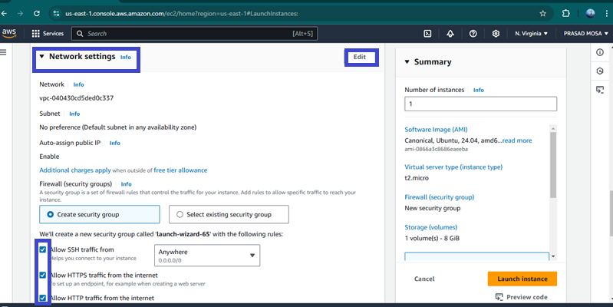
Then go the Network settings and then Allow the HTTP & HTTPS then click on Edit then add security group with All TCP then click on Launch Instance.

Slide 9
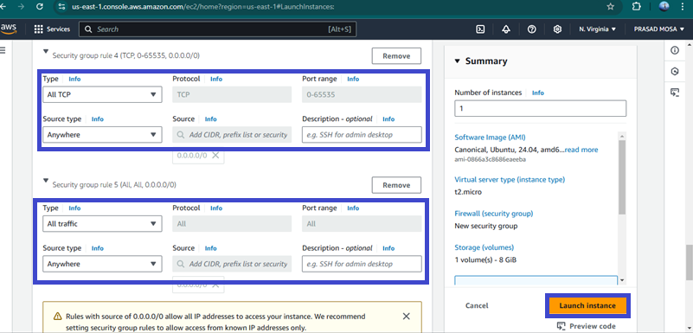

Slide 10
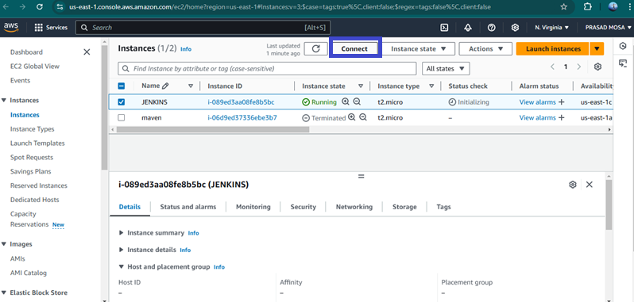
After the Instance Created then Connect the instance with any tool(Git , Mobexterm etc..,) with SSH Key

Slide 11
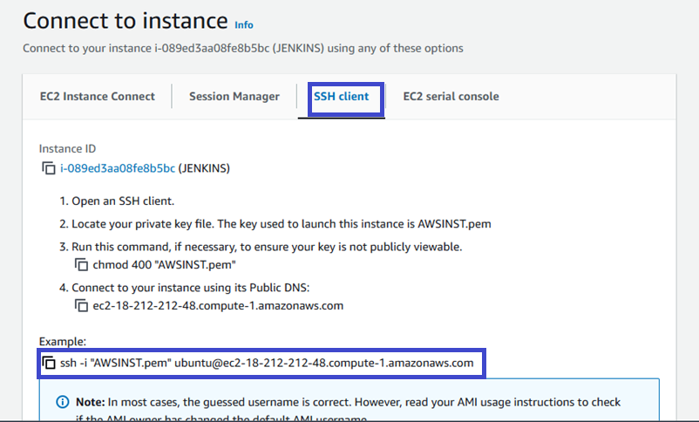

Slide 12
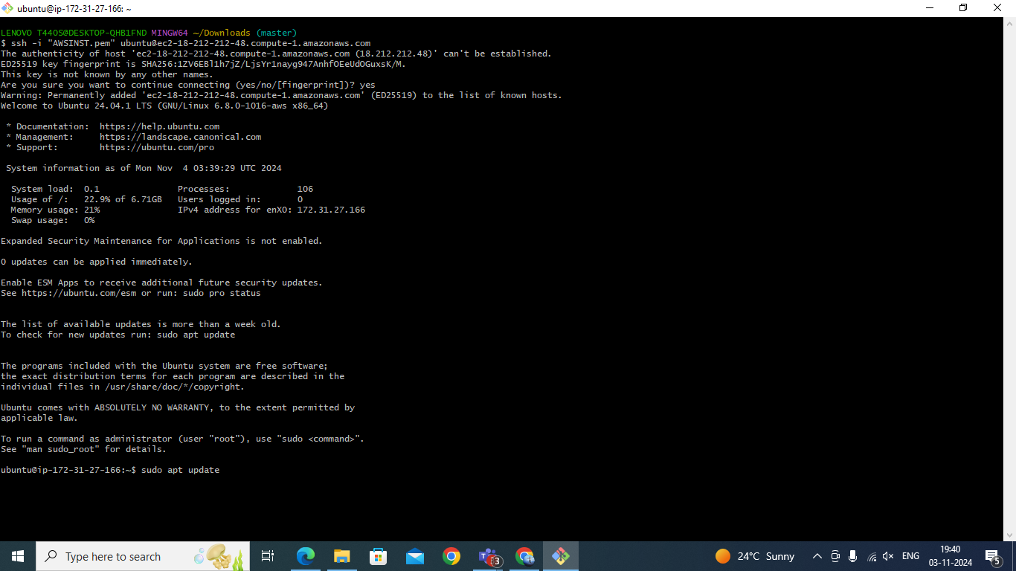
After Copy the SSH link paste that in any tool ( Git, Mobexterm etc.,) to connect with AWS.

Slide 13
To Install Jenkins follow below commands
sudo apt update -y
sudo apt upgrade -y
wget -O - https://packages.adoptium.net/artifactory/api/gpg/key/public | tee /etc/apt/keyrings/adoptium.asc
echo "deb [signed-by=/etc/apt/keyrings/adoptium.asc] https://packages.adoptium.net/artifactory/deb $(awk -F= '/^VERSION_CODENAME/{print$2}' /etc/os-release) main" | tee /etc/apt/sources.list.d/adoptium.list
Sudo apt update -y
Now need to Install Jdk in Instance for that use sudo apt install temurin-17-jdk -y

Slide 14
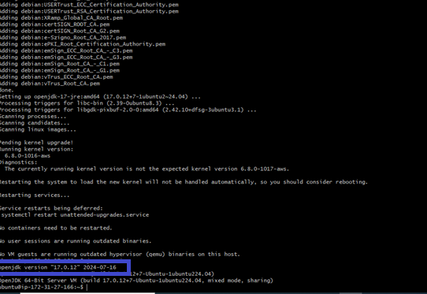
After Installing jdk check jdk version by using java --version

Slide 15
Then need to Install Jenkins before install need to add Keys for Jenkins
curl -fsSL https://pkg.jenkins.io/debian-stable/jenkins.io-2023.key | sudo tee \ /usr/share/keyrings/jenkins-keyring.asc > /dev/null
echo deb [signed-by=/usr/share/keyrings/jenkins-keyring.asc] \ https://pkg.jenkins.io/debian-stable binary/ | sudo tee /etc/apt/sources.list.d/jenkins.list > /dev/null
After Adding the keys need to install the Jenkins by using sudo apt-get install jenkins -y

Slide 16
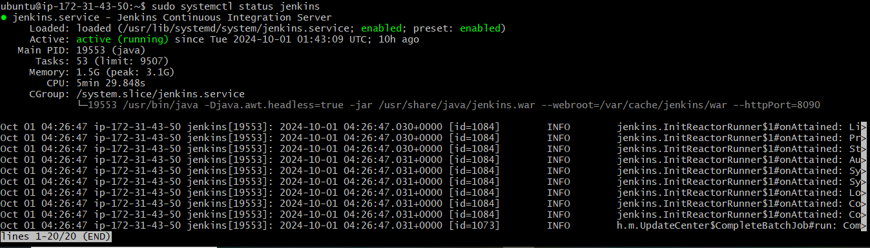
After Jenkins Installed need to check Jenkins version
Then start the jenkins by using sudo systemctl start jenkins
After starting the Jenkins need to check status of Jnekins it is active or not by using sudo systemctl status jenkins

Slide 17
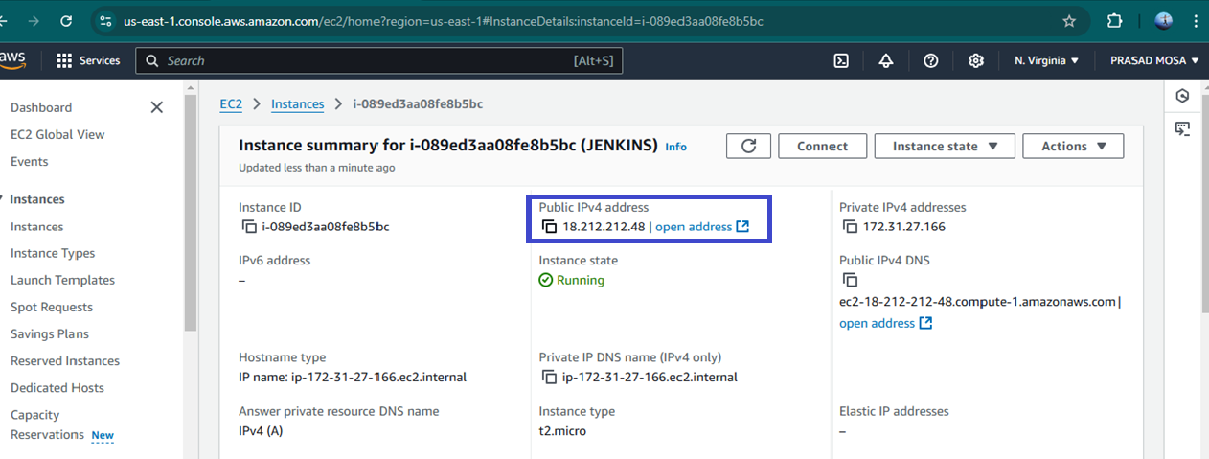
Then connect to the Jenkins dashboard by using instance public IPV4 address:8080

Slide 18
Once Jenkins is installed and connected to dashboard then for this Application case, we are running Jenkins on another port. so change the port to 8090
For changing to 8090 port first need to stop Jenkins by using Sudo systemctl stop jenkins
Then check the status of jenkins it is inactive or not by using sudo systemctl status jenkins
Now we need to change the port to 8090 for that need to change the directory by using cd /etc/default

Slide 19
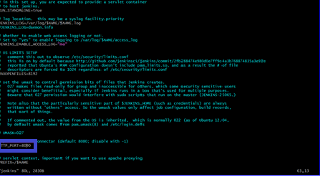
After changing into directory need to go vi editor to change the port number by using sudo vi jenkins
To exit form vi editor need to enter :wq

Slide 20
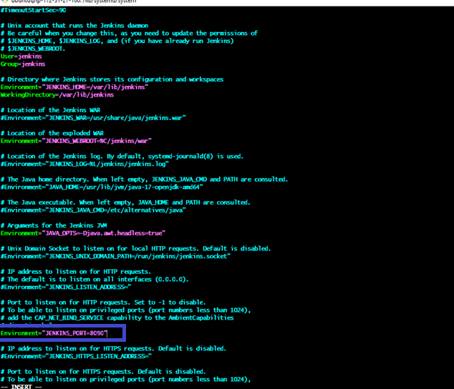
After exit from vi editor need to change to another directory by using cd /lib/systemd/system
After changing into above directory need to got vi editor again by using sudo vi jenkins.service in this need to change the jenkins port to 8090 and then exit form vi editor
After exit from vi editor need to reload the jenkins server by using sudo systemctl daemon-reload

Slide 21
Step-3: Jenkins dashboard creation
Then restart the jenkins server by using sudo systemctl restart Jenkins
After restarting the service then connect the with 8090 port
Now Unlock Jenkins using an administrative password
To get need to copy var path and paste in Git by using sudo cat var path to get administrative password

Slide 22
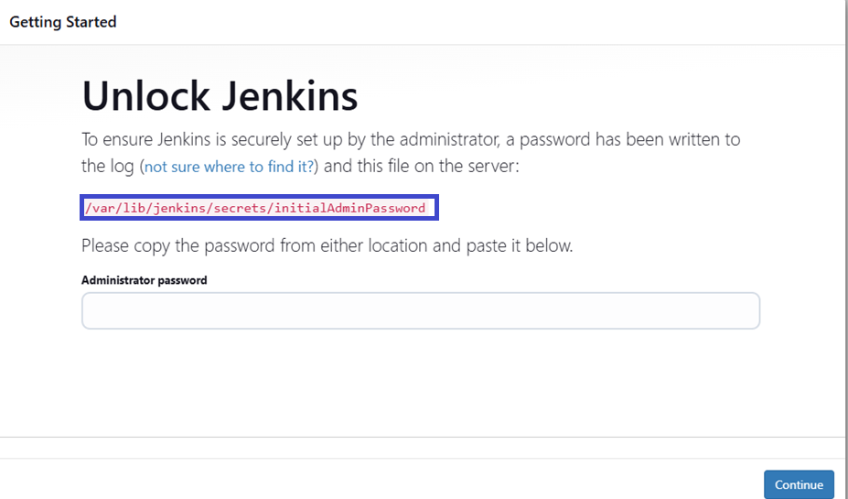

Slide 23
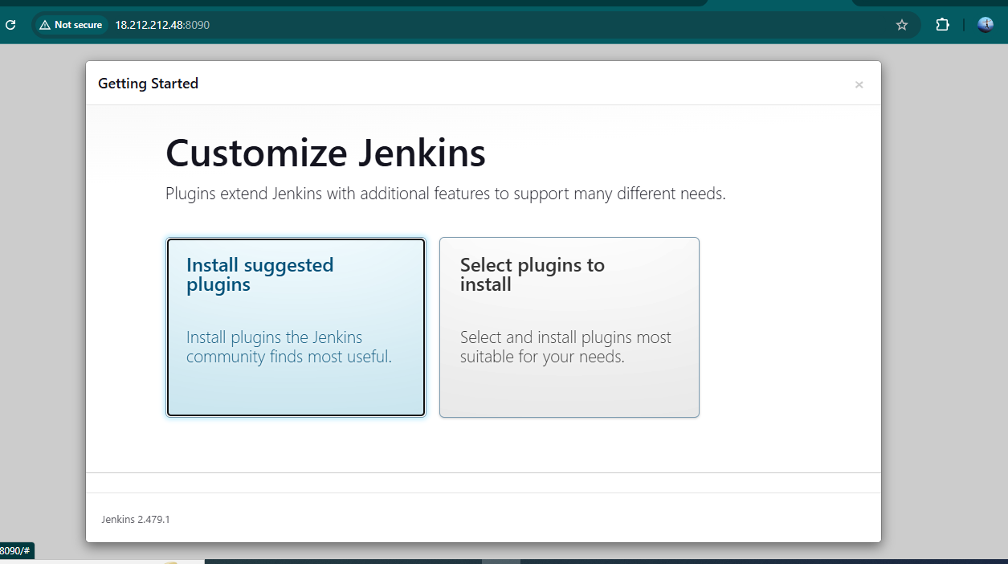
After unlocking the jenkins click on install the suggested plugins

Slide 24
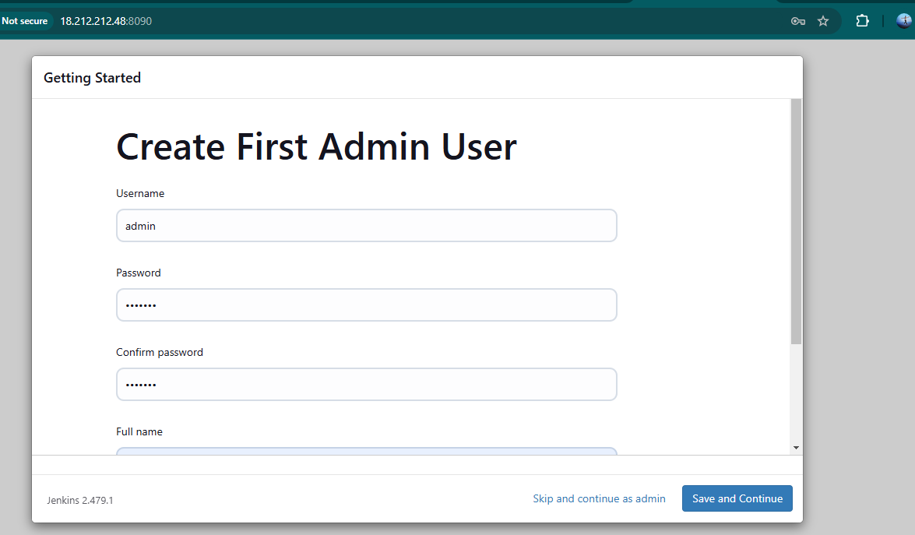
After successfully installation suggested we will get login page in that need to the enter below details
User name
Password
Conform Password
Full name
Email
After the all details need to
Click on save and continue

Slide 25
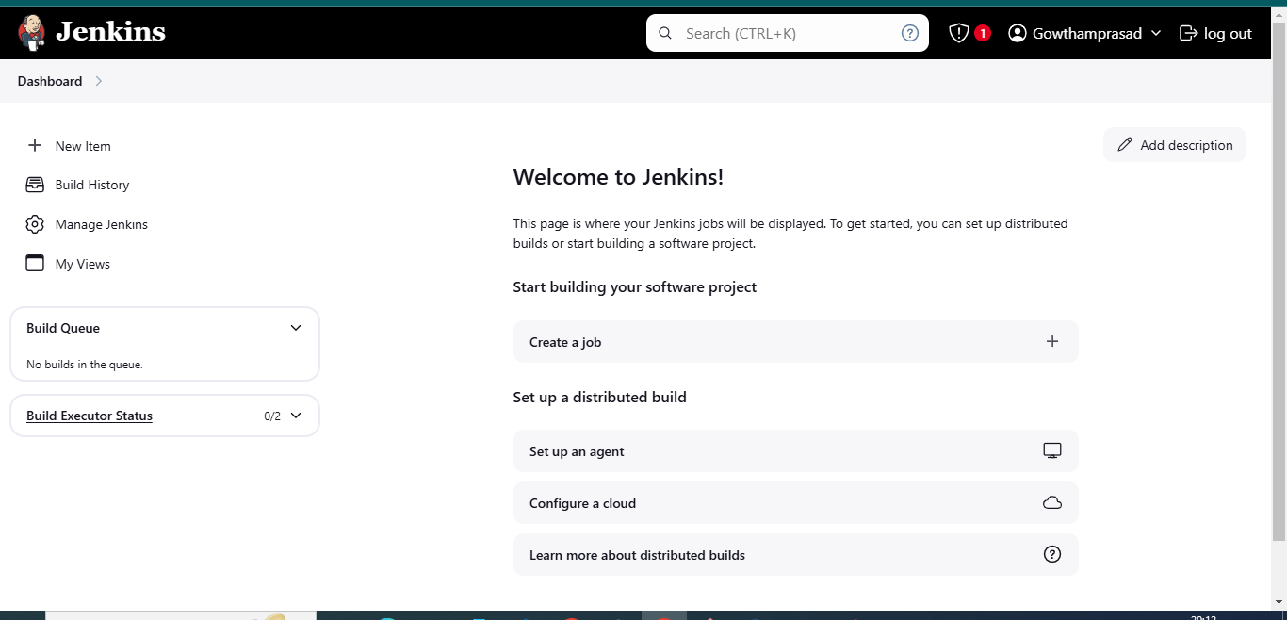
After click on save and continue Jenkins dashboard page will open

Slide 26
8.After created Jenkins Dashboard again got the Instance and install the docker
What is Docker?
Docker is an open-source platform that allows developers to automate the deployment, scaling, and management of applications inside lightweight, portable containers. These containers package an application with all its dependencies, ensuring that it runs consistently across different environments, such as development, testing, and production
Step-4:
1.Need to Install Docker Instance and connect to the sonarQube with Docker Container by using below commands
2.sudo apt-get update
3.After update the tools need install Docker by using sudo apt-get install docker.io -y

Slide 27
4.After Installing the docker create user in usermod by using sudo usermod -aG docker $USER #my case is ubuntu
5.Then New group for docker by using newgrp docker
6.After the docker installation, we create a sonarqube container by using
docker run -d --name sonar -p 9000:9000 sonarqube:lts-community
Then connect the SonarQube by using Instance public IPV4address:9000 (SonarQube default port number)

Slide 28
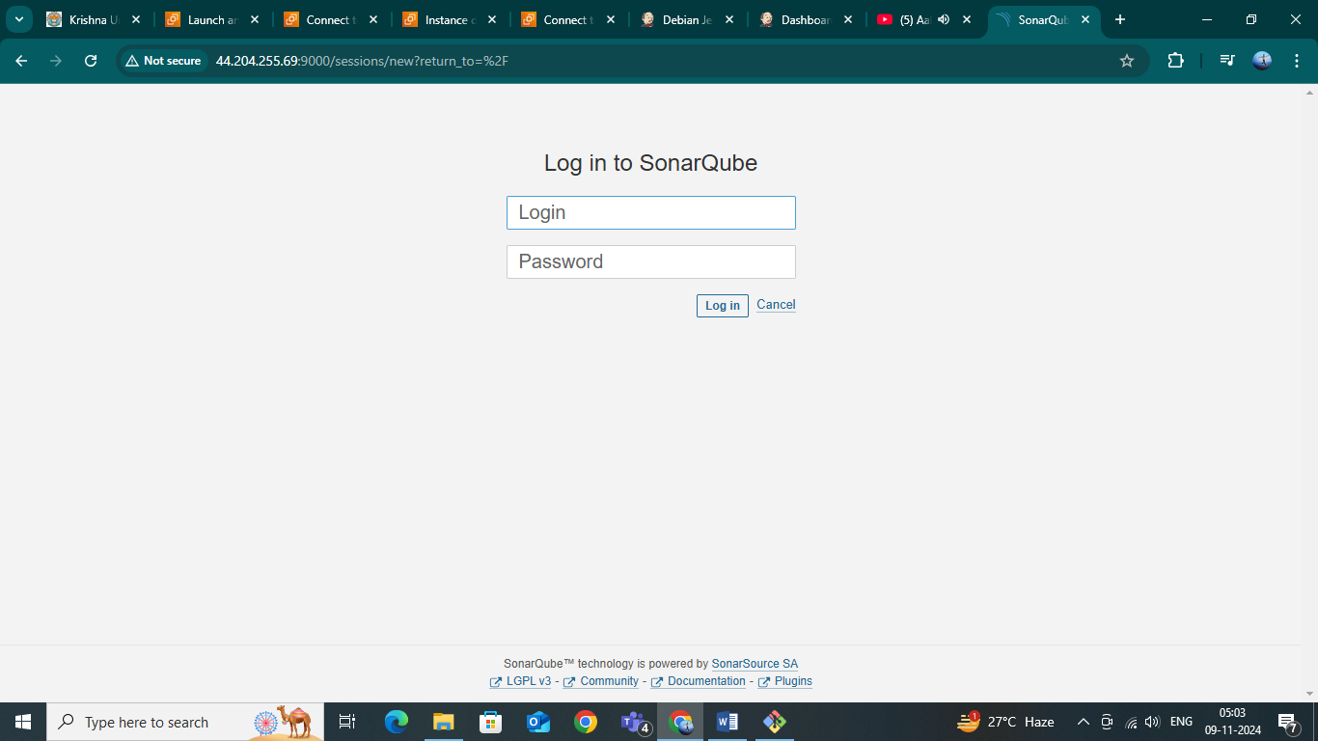
Then login with login
Enter username as admin
Enter password as admin
Then click on login

Slide 29
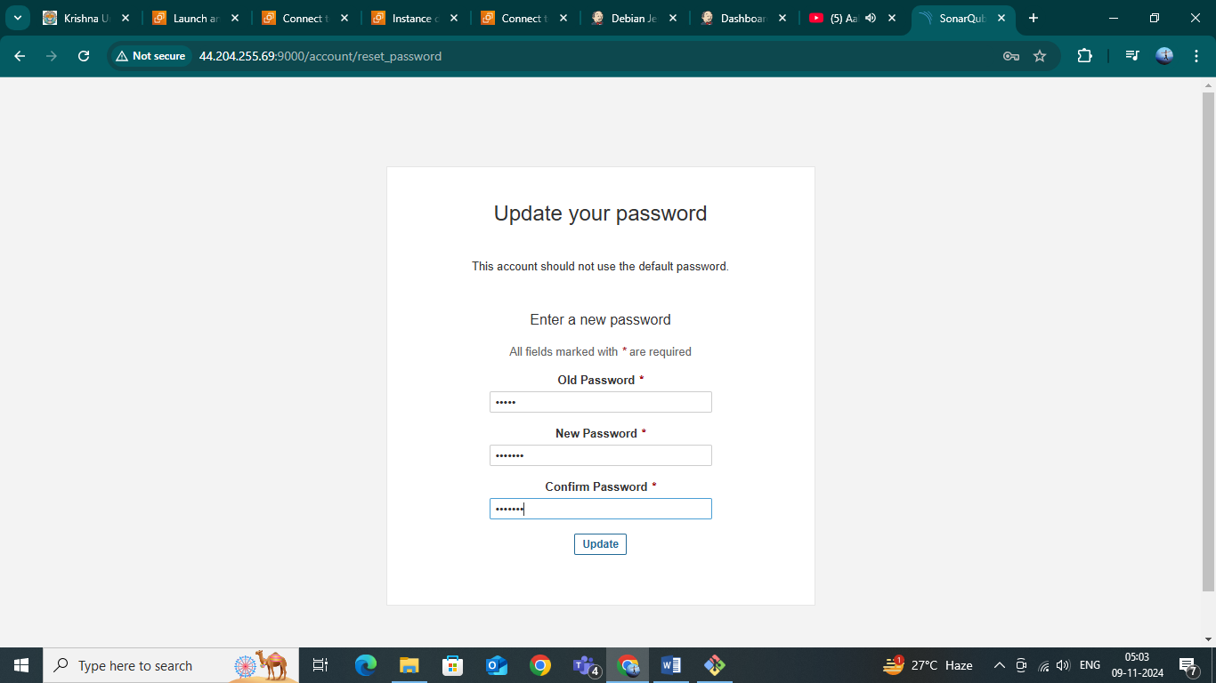

Slide 30
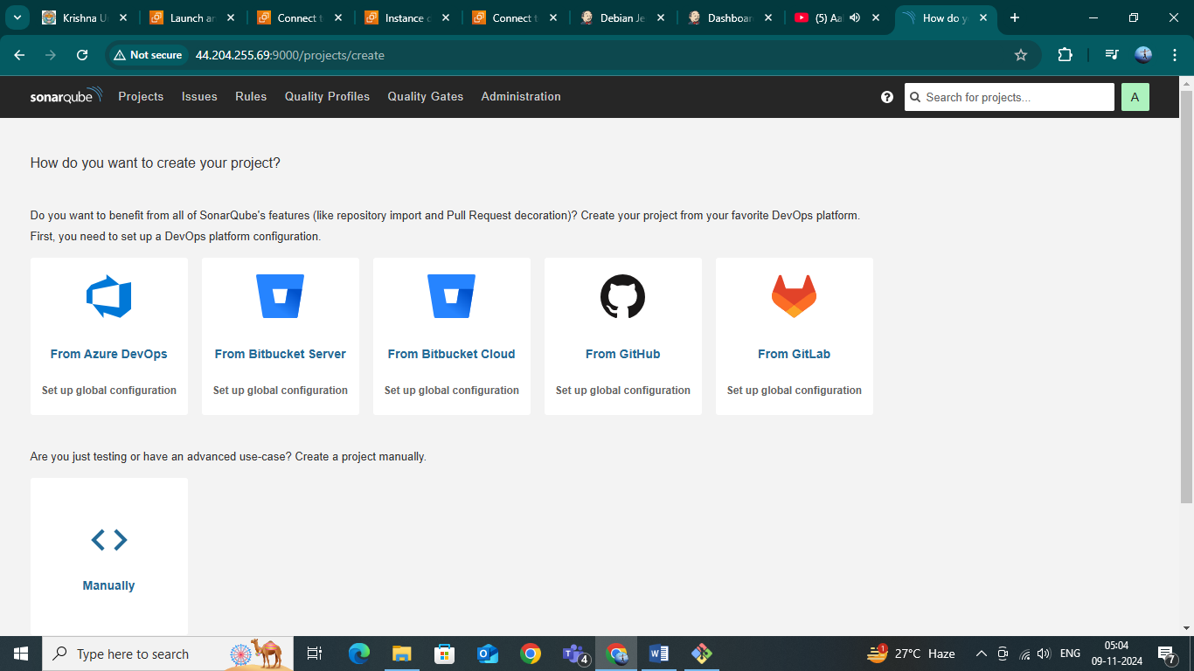
After click on the Login the SonarQube dashboard will open

Slide 31
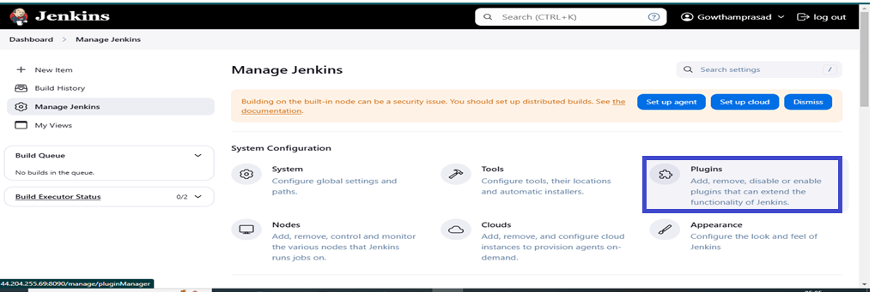
Step-5:
After completing of SonarQube connectivity need to go to the jenkins dashboard and start build the project
Step-6:
First login into Jenkins dashboard and the go to the manage Jenkins and select plugins in plugins need to select available plugins and install the required plugins
1.Eclipse Temurin Installer (Install without restart)
2.SonarQube Scanner (Install without restart)

Slide 32
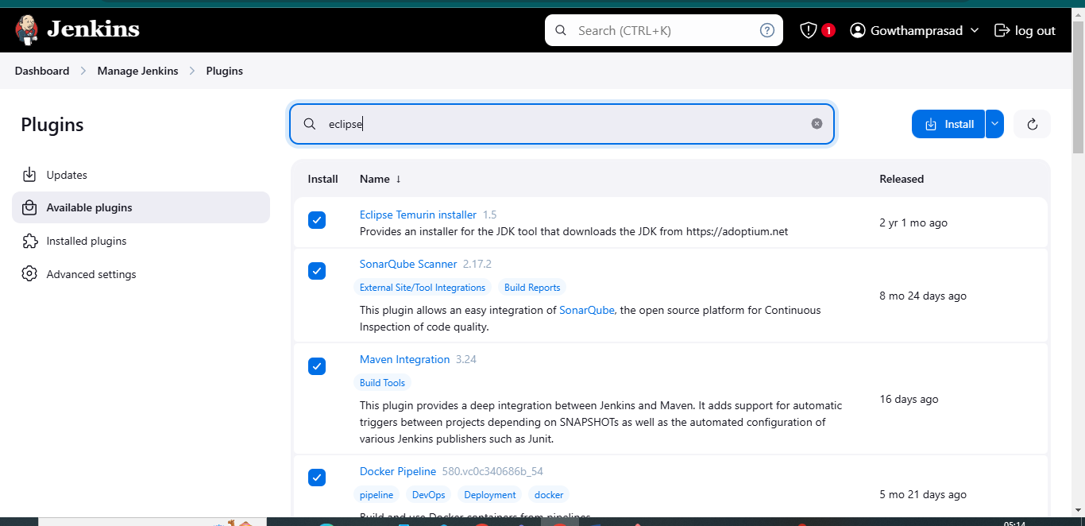

Slide 33
Docker Image Build and Push:
We need to install the Docker tool in our system, Goto Dashboard → Manage Plugins → Available plugins → Search for Docker and install these plugins
Docker
Docker Commons
Docker Pipeline
Docker API
docker-build-step
and click on install without restart

Slide 34
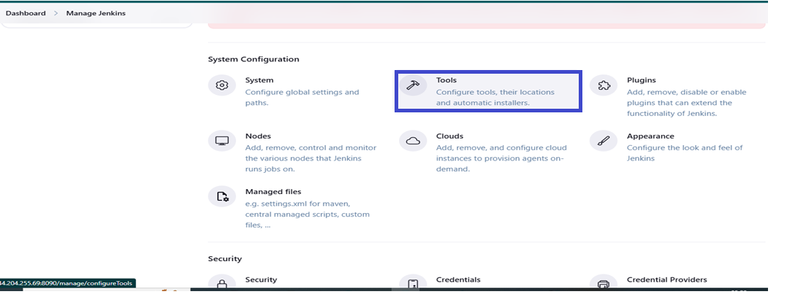
Step-7:
Then again go to the Manage Jenkins and select Tools.

Slide 35
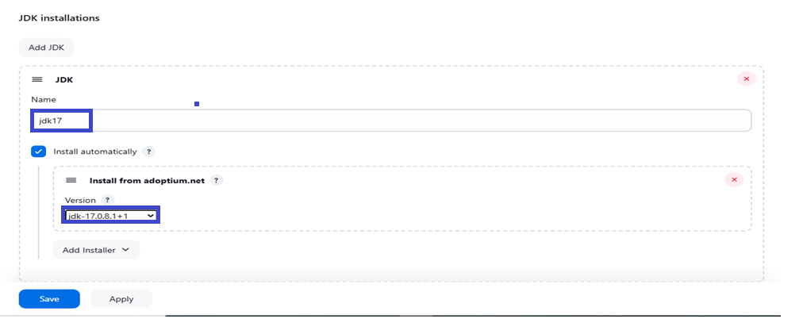
In Tools need to add jdk installation and maven installation
Add jenkins Installation
Name
Java Version (jdk-17.0.8.1+1)

Slide 36
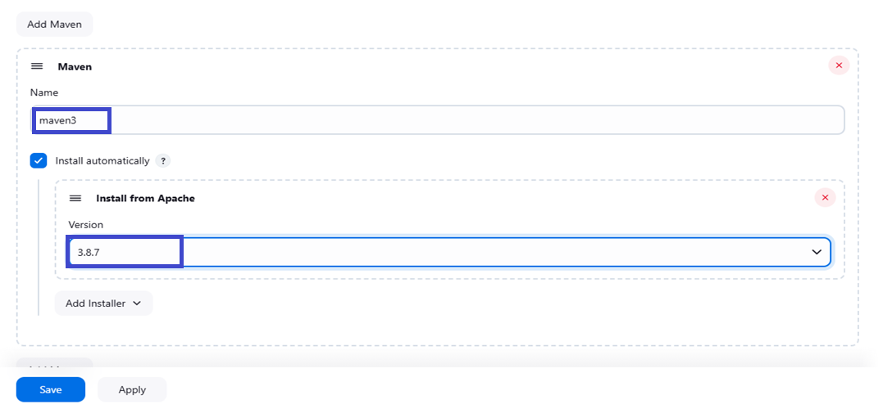

Slide 37
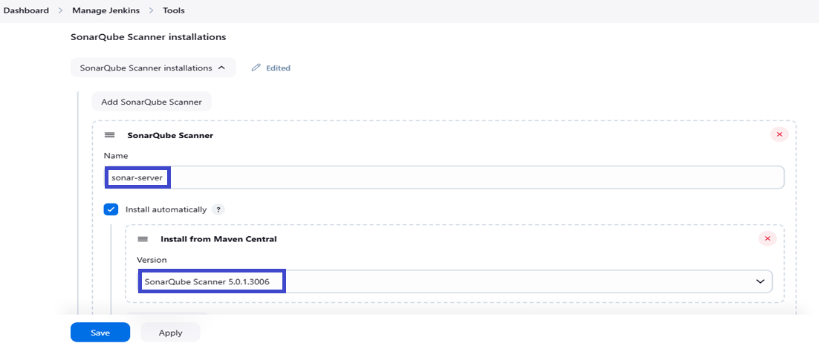

Slide 38
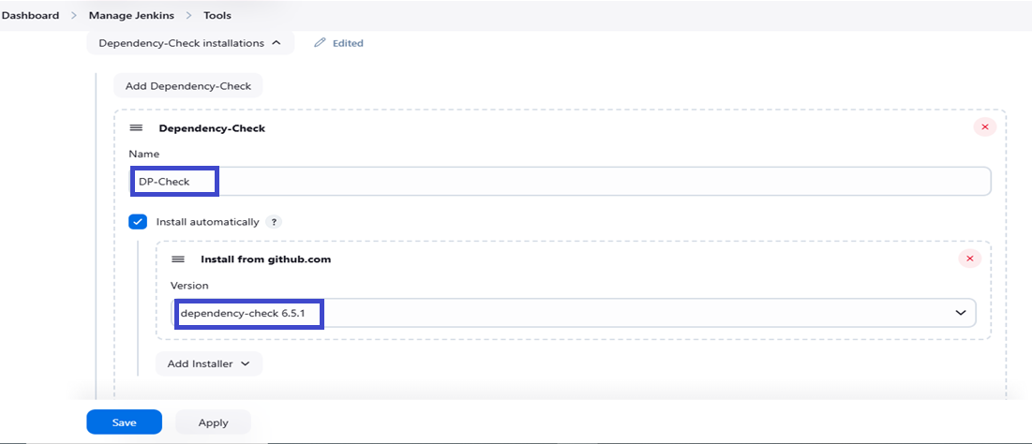

Slide 39
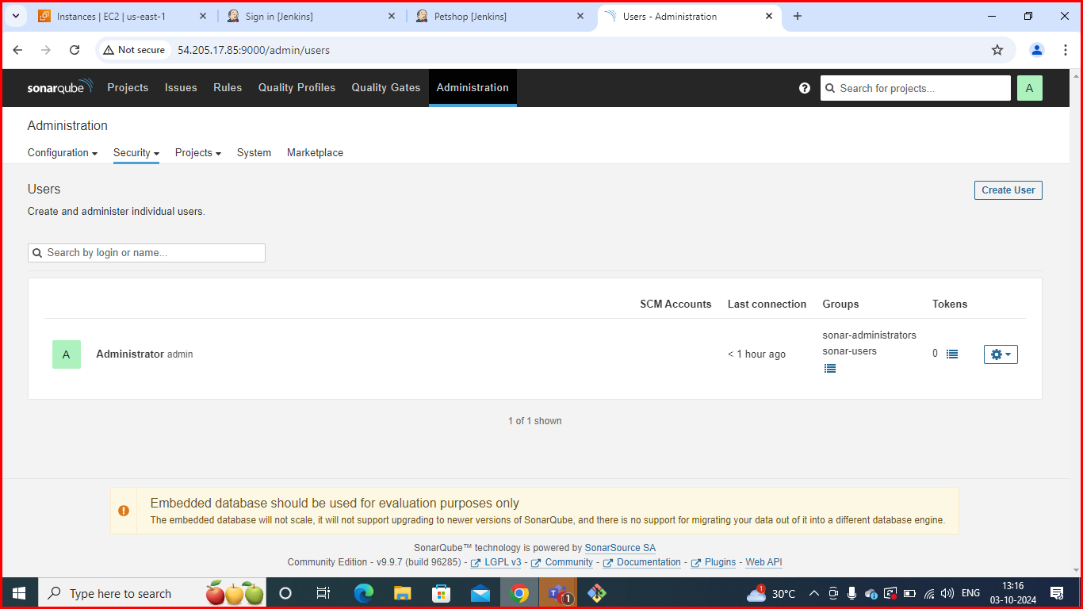
Configure Sonar Server in Manage Jenkins
Create a token with a name and generate:

Slide 40
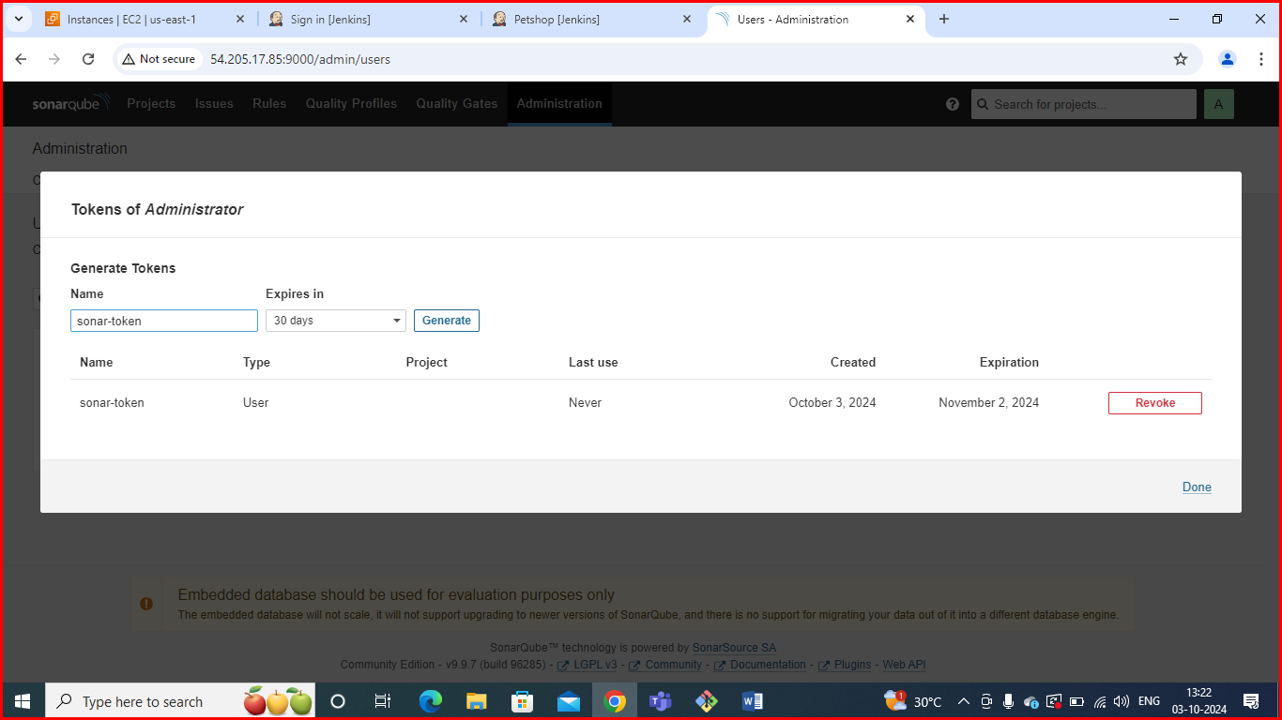
Copy token:

Slide 41
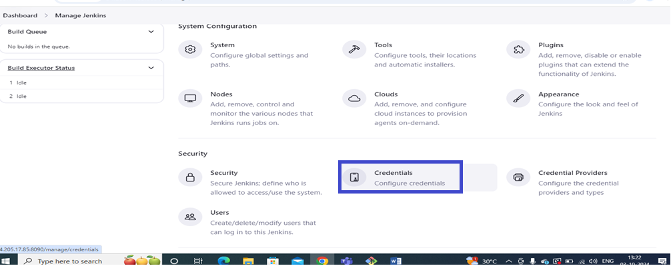
Go to Jenkins Dashboard → Manage Jenkins → Credentials

Slide 42
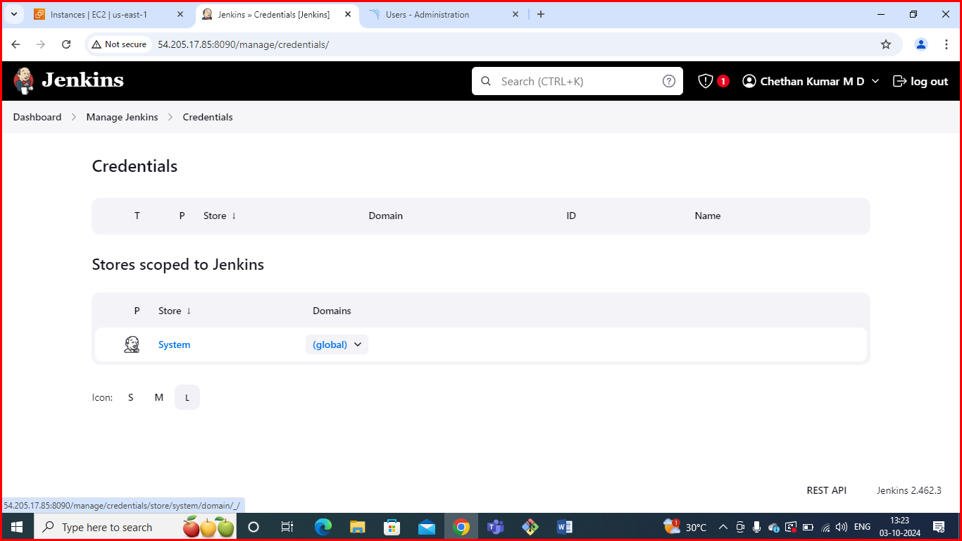
In credentials click on global :

Slide 43
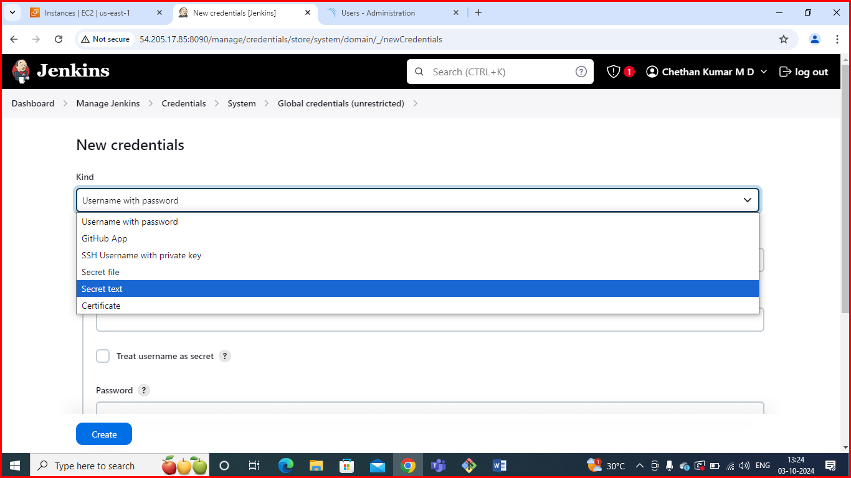
Add Secret Text:

Slide 44
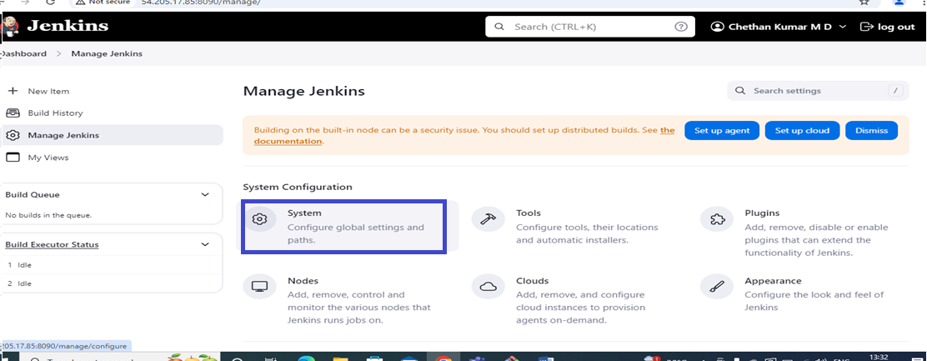
Now, go to Dashboard → Manage Jenkins → System

Slide 45
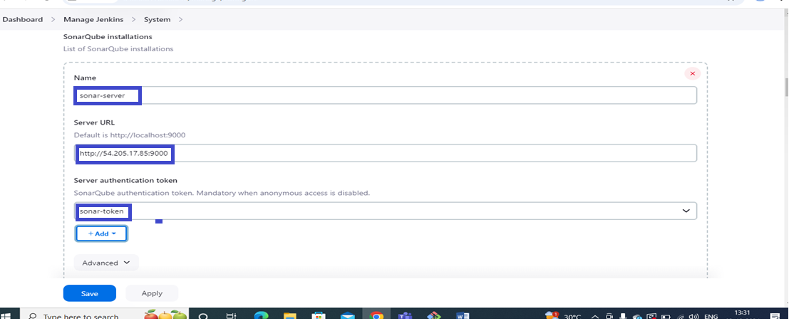
Here give name and paste url of sonar cube.

Slide 46
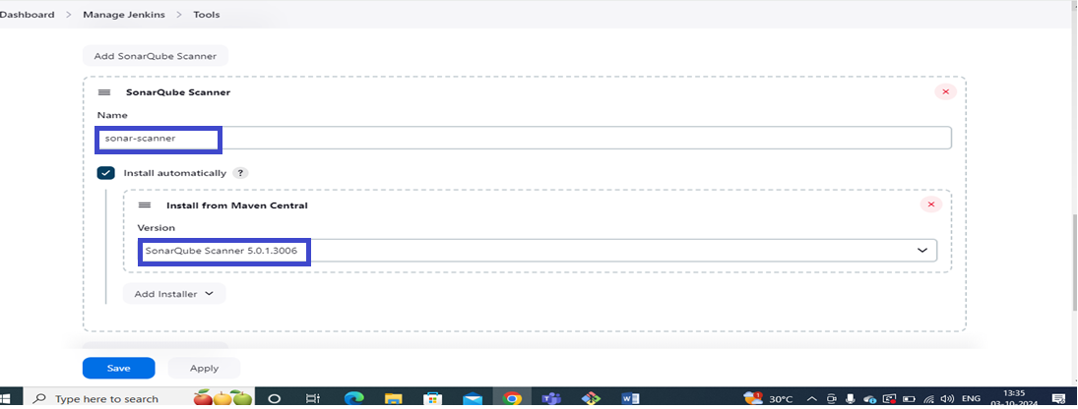
The Configure System option is used in Jenkins to configure different server
Global Tool Configuration is used to configure different tools that we install using Plugins
We will install a sonar scanner in the tools.

Slide 47
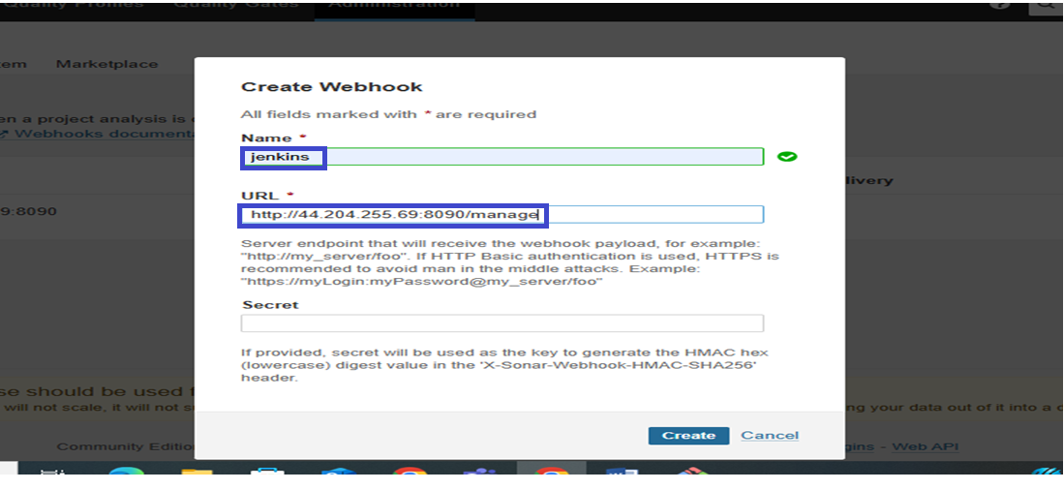
In the Sonarqube Dashboard add a quality gate also
Administration--> Configuration-->Webhooks

Slide 48
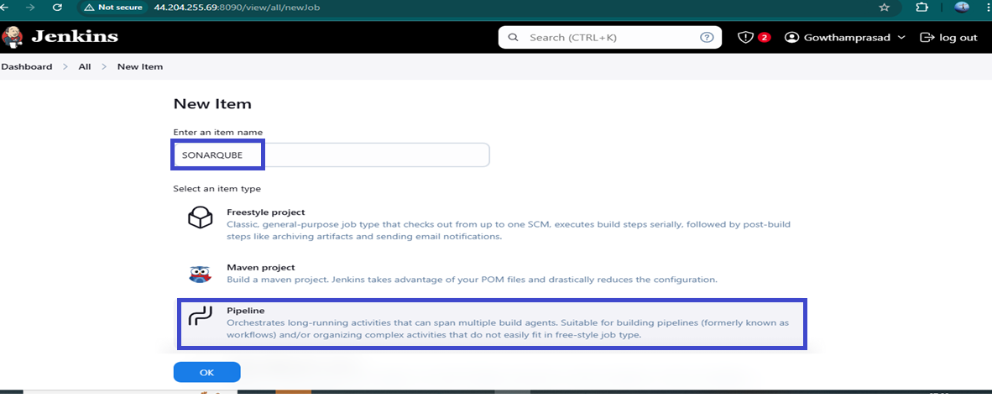
Step-8:
After providing all the information need to Create a new project with Pipeline

Slide 49
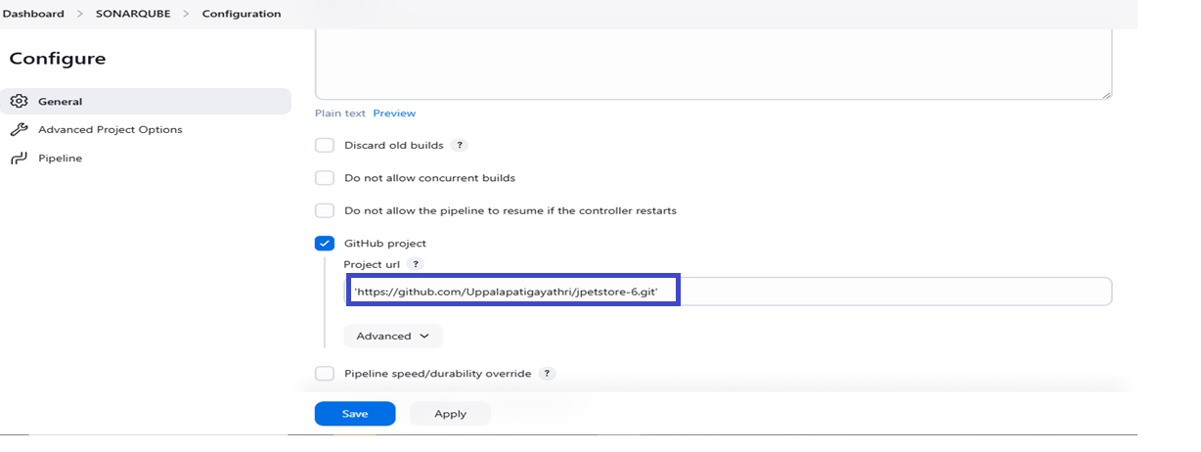
Step9:
After Click on Ok the configure page will open
In General Tab need to provide the decesription

Slide 50
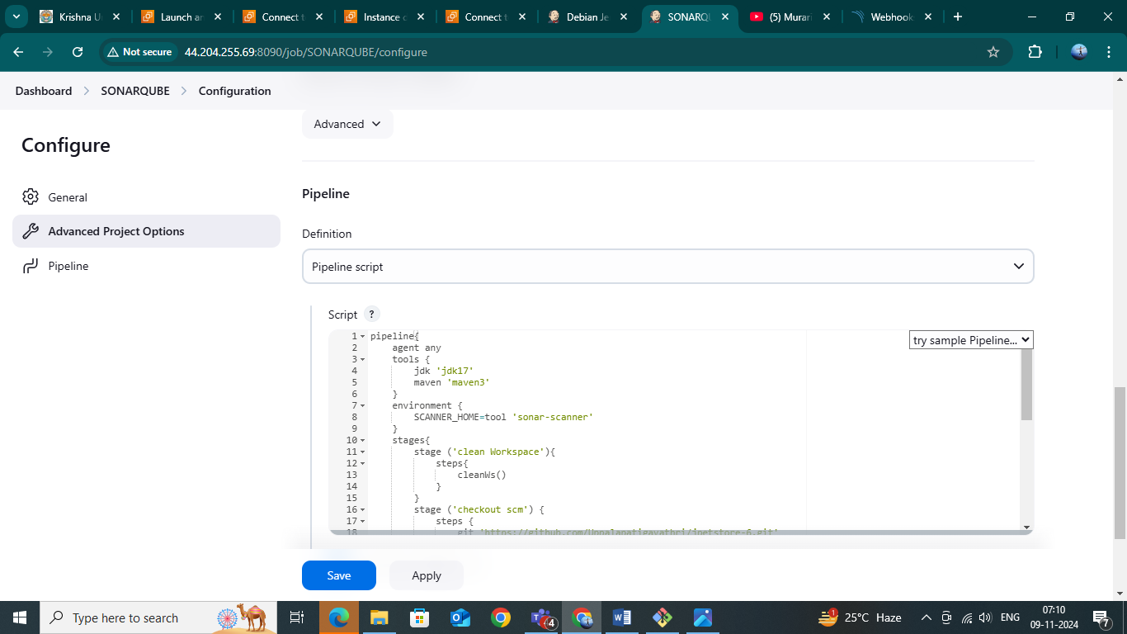
Step-10:
Then go the Pipeline in Configure and then provide the pipeline script Then Apply and Save.

Slide 51
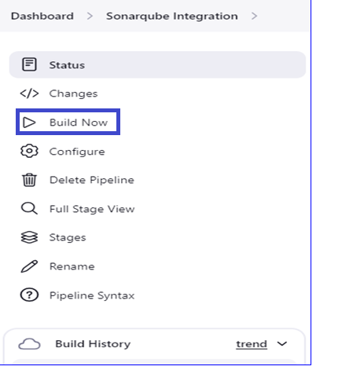
Step-11:
After save the configure page then click on Build Now.

Slide 52
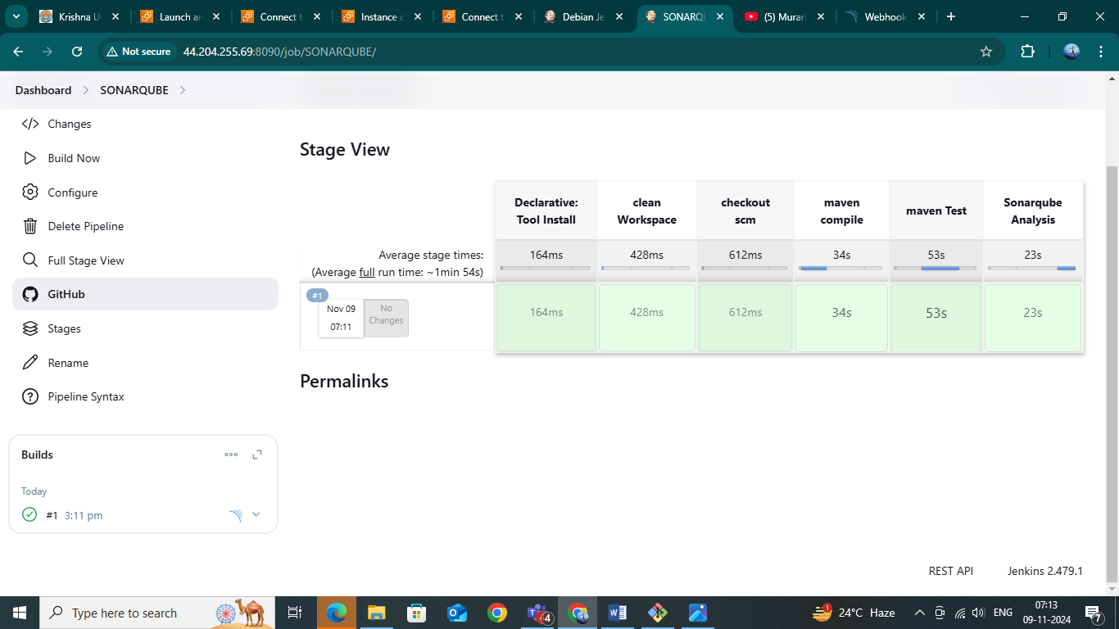
Step-12:
After Click on Build Now you will get success output.

Slide 53
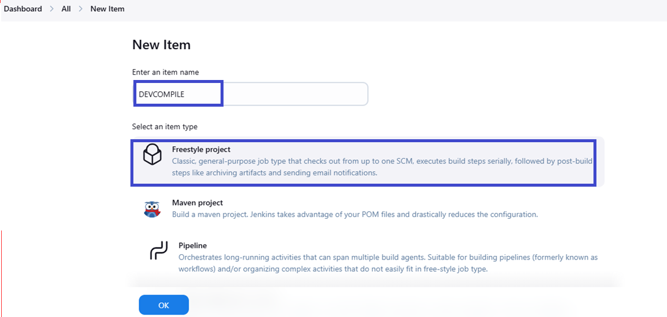
Create Pipeline view using DevCompile and QAUnitTest

Slide 54
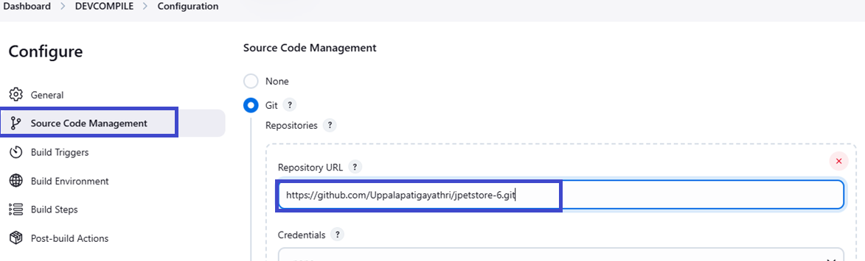
Source Code Management (SCM) is the practice of tracking and managing changes to code during the software development process

Slide 55
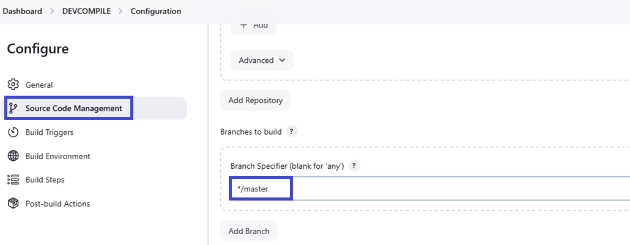

Slide 56
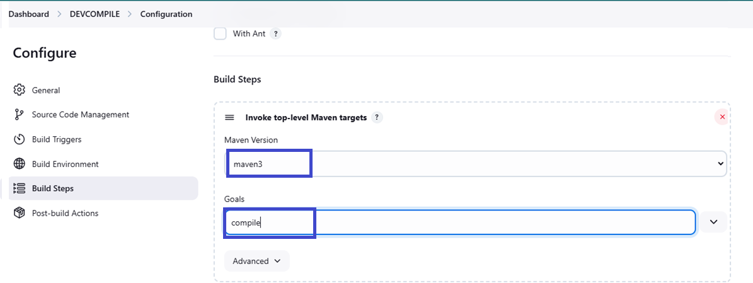
A build step is a stage in the software development pipeline where the source code is transformed into an executable product or a deployable artifact. This process typically involves compiling code, linking dependencies, running tests, and packaging the outpu

Slide 57
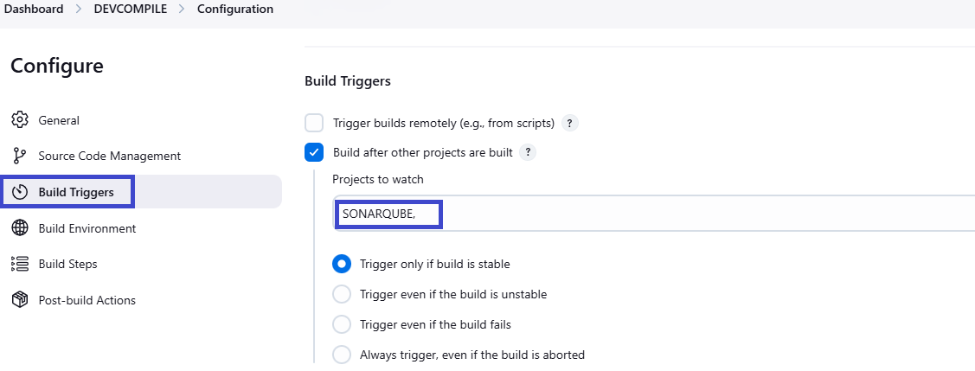
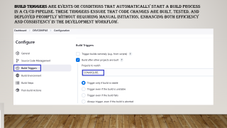
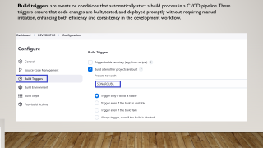
Build triggers are events or conditions that automatically start a build process in a CI/CD pipeline. These triggers ensure that code changes are built, tested, and deployed promptly without requiring manual initiation, enhancing both efficiency and consistency in the development workflow.

Slide 58

Post-build actions are tasks or processes that occur after a build completes in a CI/CD pipeline. These actions are critical for further testing, packaging, deployment, and reporting, ensuring that the software meets the desired quality standards and is ready for the next stage of the development lifecycle.

Slide 59


Slide 60


Slide 61

▪ Go to Jenkins Dashboard and click on the “+” button. That button is for adding a view. ▪ You will be redirected to the following screen. ▪ Give the View name and Select the build Pipeline View radio button, and press OK

Slide 62


Slide 63


Slide 64


Slide 65


